Slide 1
The Source Approval Request (SAR) Process
Jamie Spangler, SAR Monitor

Slide 2


Purpose
Increasing competition for items that require an approved manufacturer
Going from single source, or small number of sources, to multiple sources of supply

Slide 3
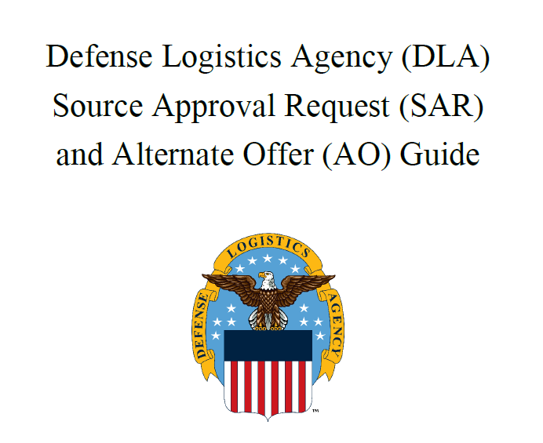
Where do I start?
Use the DLA SAR Guide
  Guide includes detailed information about what needs to go into your package

Slide 4
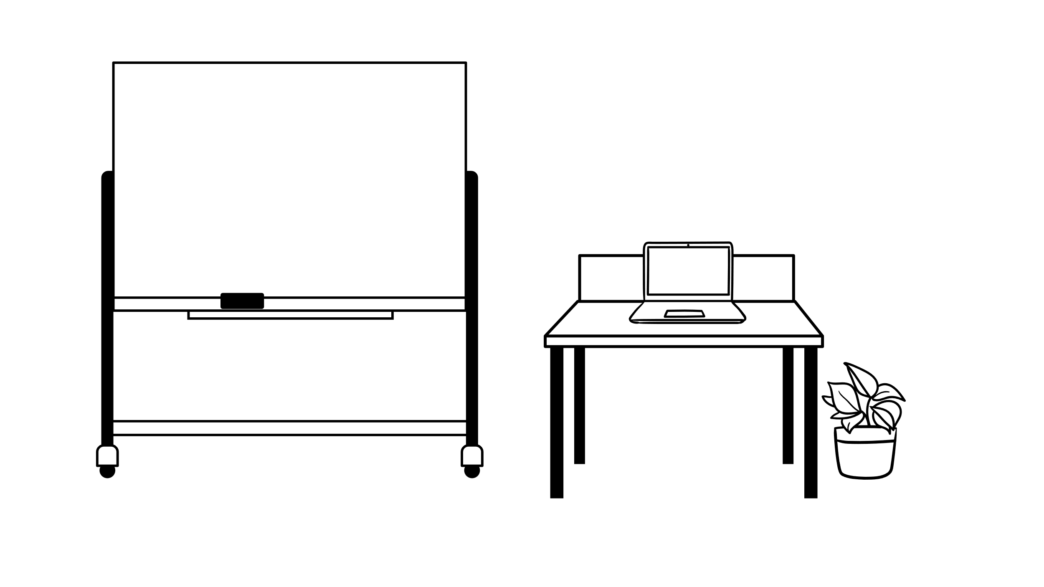
SAR Defined
Source Approval Request (SAR) – A Source Approval Request is a package of information provided by a prospective new supplier to become an approved source for procurement of an NSN. This package must contain all technical data needed to demonstrate competence to manufacture the NSN to the same, or better, level of quality than the current approved source(s) and can be submitted at any time.
Submission can be made at ANY time and does not require an active solicitation!

Slide 5


AO Defined
Alternate Offer (AO) – An “Alternate Offer” is submitted for evaluation against an active solicitation in order for a company and their product information to be reviewed, potentially qualifying them as an “Approved Source” on current (and future) solicitations.
Hey! My company can make this. I will submit my offer, AND technical data!

Slide 6
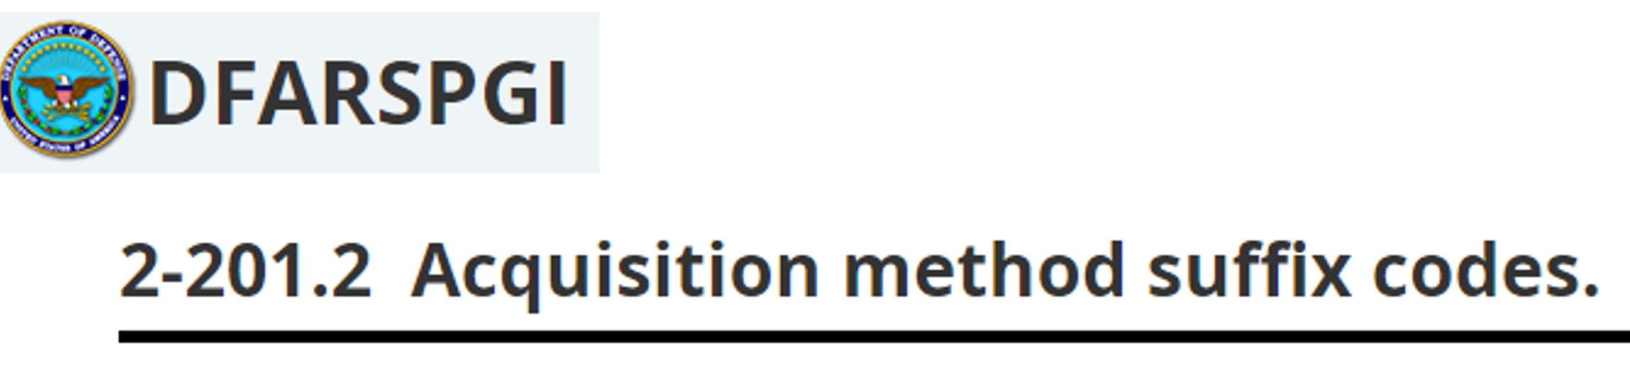
Any Restrictions?
Acquisition Method Suffix Code (AMSC)
  Must not be coded as “G” for full and open competition – these don’t require approval, just go ahead and bid!
  Must be coded as “other than full and open competition,” for example:
    Source Controlled (AMSC B)
    Source Restricted (AMSC C)
    Code & Part Number (AMSC D)

Slide 7

Choosing a Category
Category I – Actual Item: A company may submit a Category I package if they make the exact material, can prove this with thorough documentation, and the material has been provided to the government
This category is for you if you have made the EXACT item before, to drawing specifications, and have provided the item to the government.

Slide 8

Choosing a Category
Continued
Category II - Similar Part: A company may submit a Category II package if they make a similar part and can prove they have the capability to make the exact part
This category is for you if you haven’t made the EXACT part and provided it to the government, but you have made something very similar in fit, form, function, and criticality – and provided those to the government.

Slide 9

Choosing a Category
Continued
Category III - New Manufacturer: This category covers items that do not meet Category I or II criteria, but the company may have capabilities to make the exact part and can fully demonstrate those capabilities
This category is for you if you have not made the exact item for the government, but you are a proven manufacturer and can demonstrate your capabilities to produce the exact item.

Slide 10

Choosing a Category
Continued
Category IV – Reverse Engineered Part: Submissions for material under Category IV are submitting for source approval by means of reverse engineering (done at the expense – and risk – of the supplier)
This category is for you if you have reverse engineered an actual approved item that was procured through the government, and have done all required testing, inspection, etc., to build an entire technical data package, including drawings and manufacturing plan.

Slide 11




Package Considerations
Provide all required elements defined in the Defense Logistics Agency (DLA) Source Approval Request (SAR) and Alternate Offer (AO) Guide
Inclusion of the potential replacement product:
  Estimated unit price
  Quantity ranges (and if quantity influences price)
  Clear identification of the actual manufacturer (Company Name, CAGE Code, Point of Contact, Manufacturing Site, etc.)

Slide 12
Technical Data
Technical data must include:
  Legible and complete copies of all drawings (signed and approved), specifications or other data necessary to clearly describe the characteristics and features of the product offered
  Cover design, materials, performance, function, interchangeability, inspection and/or testing criteria and other characteristics
  Required Certifications for Master Tooling, Technical Data Rights, etc.
  Value Added
  Reference DLAD Procurement Note L04 Offers for Part Numbered Items (SEP 2016)

Slide 13
Submission
Format:
  Electronic copy via email, requested DoD Safe link
    Please note, the preferred submission format is via email. If your package is too large for email, a DoD Safe link will be provided at your request.
  Cover letters should clearly identify the package as an Alternate Offer or SAR, along with other info outlined in Land and Maritime guidance
  Submit only one .pdf file for each NSN. No ZIP files.
  NO password protected files
  Always retain copies. AO and SAR submissions will not be returned.

Slide 14
Submission
Continued
Submission (with technical data)
  Contracting Officer (KO)
    AO may be submitted to the KO listed in all manual solicitations. The KO will forward for review.
  SAR Monitor, Competition Advocate Office (CAO)
    AO for automated solicitation must be submitted to the SAR mailbox
    SAR may be submitted directly to the SAR Monitor for review and evaluation (preferred)
    dsccao-sar@dla.mil
It is acceptable, and encouraged, to send your alternate offer to the Contracting Officer AND the SAR monitor address to ensure it is received.

Slide 15

Tracking
Tracking/Administrative Review
  SAR Monitor will log in all submissions for tracking and notify contractor of receipt
  SAR Monitor will perform the initial review to include projected cost savings, coordinating with the KO (if applicable) and Product Specialist (PS) as needed
  Packages that appear to meet minimum requirements are forwarded to Value Engineering (VE) for further review
Who is tracking
my package?

Slide 16
Notification
Notification
  Once a decision is made, the manufacturer will receive a formal notification from the SAR/Alternate Offer Monitor
  If the AO/SAR package is approved, the manufacturer will receive written authorization to participate as an Approved Source for the specific NSN in future procurements
  If the AO/SAR package is rejected, the SAR monitor will provide reasons, and will answer any questions
Please note: becoming an approved source of supply only grants the opportunity to compete to supply the item – it does not guarantee future contracts or orders.

Slide 17
1st Year as Source Approved
DLA Land and Maritime
While awards are NOT guaranteed:
  The Government reserves the right to make multiple awards if, after considering the additional administrative costs, it is in the Government’s best interest to do so
  If awards will be made to more than one source, the offer that represents the best value to the Government shall receive not less than 60% of the total requirement
  Unless an offeror submits unit prices for other quantities, unit prices submitted for the total requirement will apply to any partial awards
  In short, we will do our best to ensure you are given the opportunity to compete for items you are a newly approved source on – and will continue to support your effort.

Slide 18
Important Note
Award of Solicitations will not be delayed due to pending AO/SAR package evaluations. The only exception will be for non- critical/weapon system items when mission requirements allow, and there are no qualified sources quoting.
The SAR program allows for submission at any time, whether an open solicitation has been published for the subject NSN, or not

Slide 19

Resources
AO/SAR submission dsccao-sar@dla.mil
Technical Issues ve.sar@dla.mil
(Engineering/Analysts)
RPPOB DSCC.PartRequest@dla.mil
Land and Maritime SMBIZLandCOLS@dla.mil
Small Business Office
Need assistance?
I’m here to help!

